Slide 1
Google Analytics Customer Revenue Prediction
Radhika Malviya
Bhushit Nema
Aman Manawat
Chantal de Souza

Slide 2
Agenda
Introduction
Background
Data Availability
Data Exploration
Sampling
Data cleaning
EDA
Model Generation
1. Classification Models - Rev/ No Rev
2. Continuous Models - log fn
Model Validation
Parameter Tuning
Model Comparison
Learning Curve
Conclusion
Insights & Recommendations

Slide 3
Introduction

Slide 4
Background
The 80/20 rule is true for many businesses
Analyze GStore (Google Merchandise) customer dataset
Predict Revenue per customer
However, we observed that only ~1% actually buy
Useful for marketing teams to make appropriate investments for promotional strategies

Slide 5
Data Fields
fullVisitorIdv - A unique identifier for each user of the Google Merchandise Store.
channelGrouping - The channel via which the user came to the Store.
date - The date on which the user visited the Store.
device - The specifications for the device used to access the Store.
geoNetwork - This section contains information about the geography of the user.
sessionId - A unique identifier for this visit to the store.
socialEngagementType - Engagement type, either "Socially Engaged" or "Not Socially Engaged".
totals - This section contains aggregate values across the session.
trafficSource - This section contains information about the Traffic Source from which the session originated.
visitId - An identifier for this session. This is part of the value usually stored as the _utmb cookie. This is only unique to the user. For a completely unique ID, you should use a combination of fullVisitorId and visitId.
visitNumber - The session number for this user. If this is the first session, then this is set to 1.
visitStartTime - The timestamp (expressed as POSIX time)

Slide 6
Exploratory Data Analysis

Slide 7
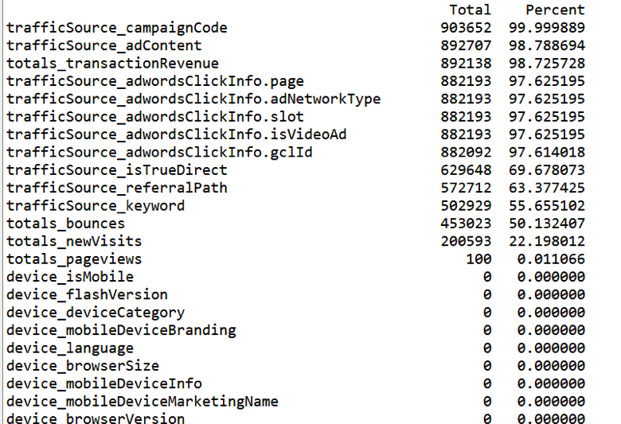
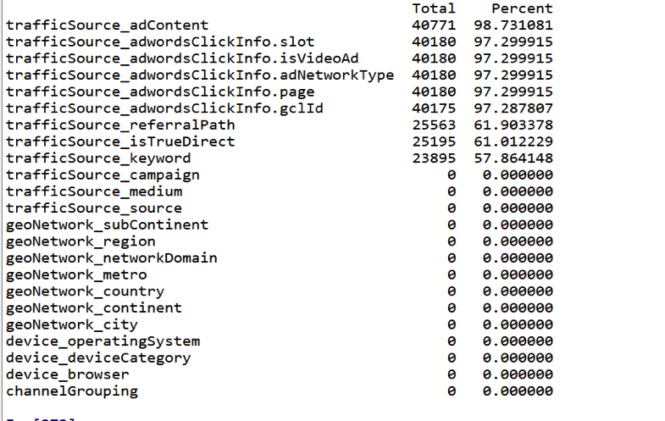
Sampling
Original Dataset
Sampled Dataset

Slide 8
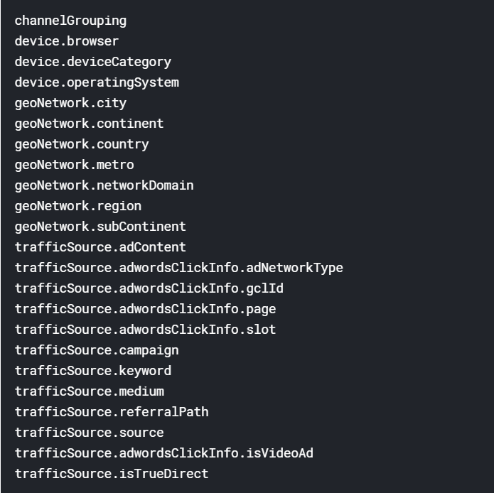
Variable Selection

Slide 9
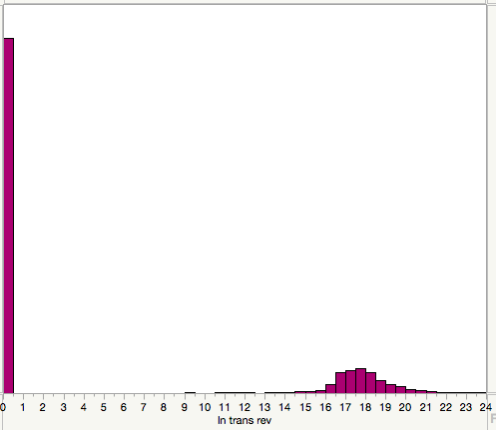


Target Variable Exploration
To predict the natural log of sum of all transactions of the user
Sum up the transaction revenue at user level and take a log and then plot a histogram.

Slide 10
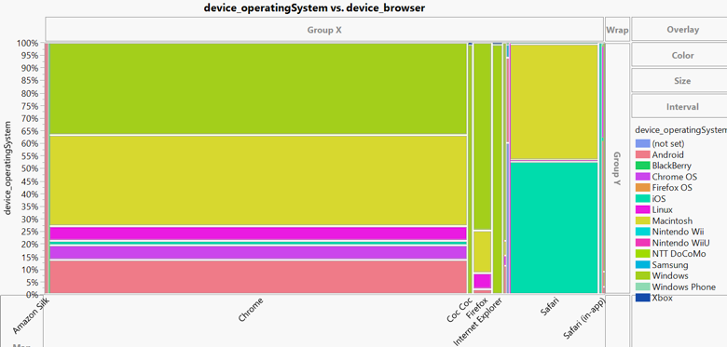
Relation between browser and operating system

Slide 11
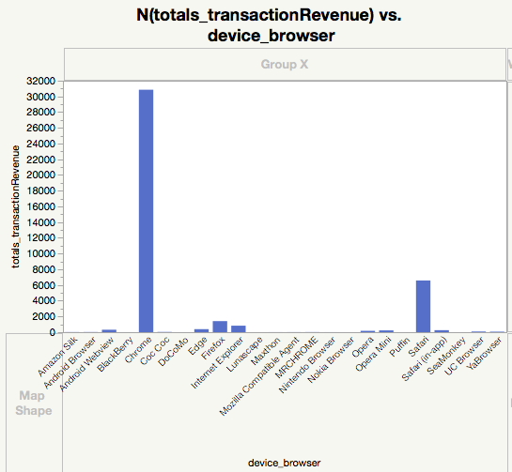
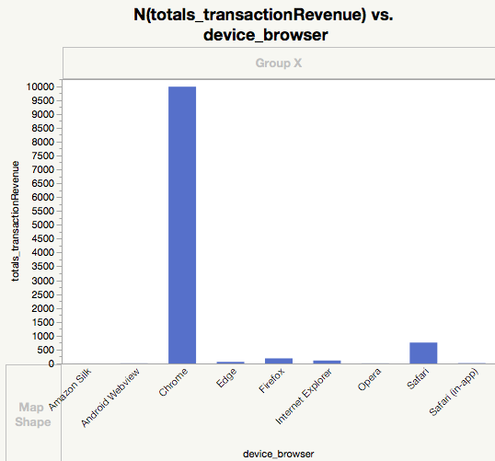
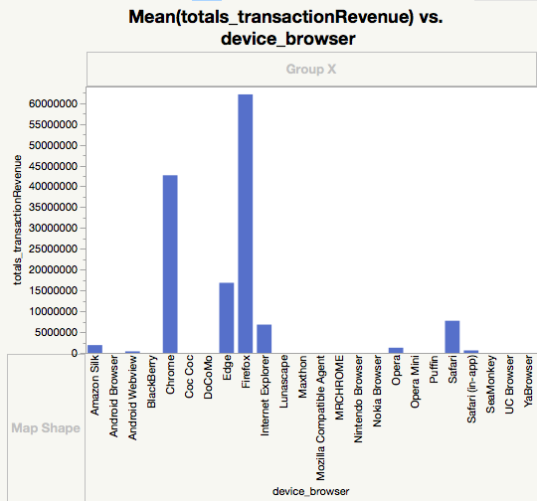
Device Browser
Count
Non-zero Revenue Count
Mean Revenue

Slide 12
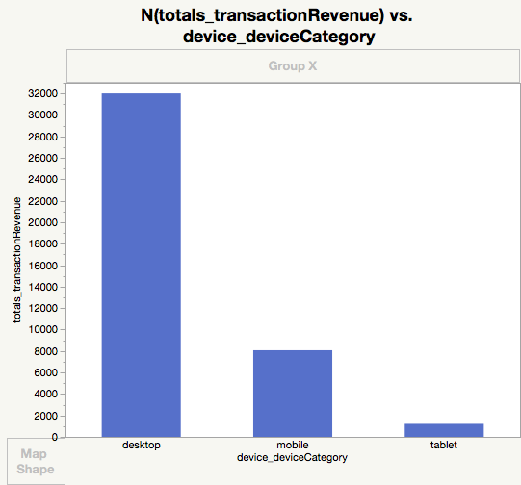
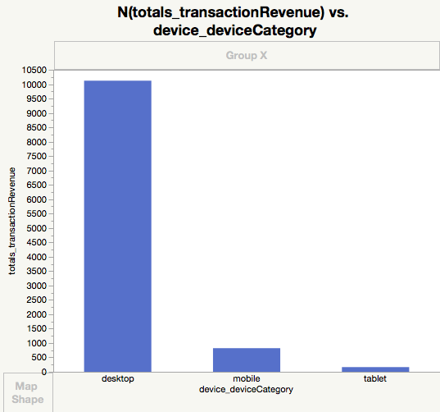
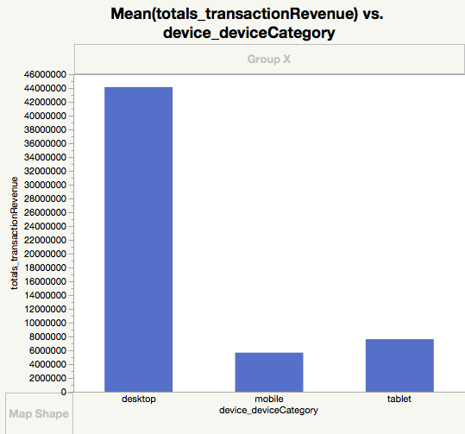
Device Category
Count
Non-zero Revenue Count
Mean Revenue

Slide 13
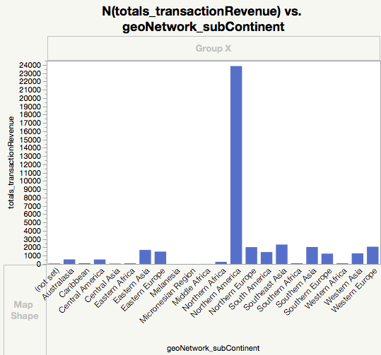
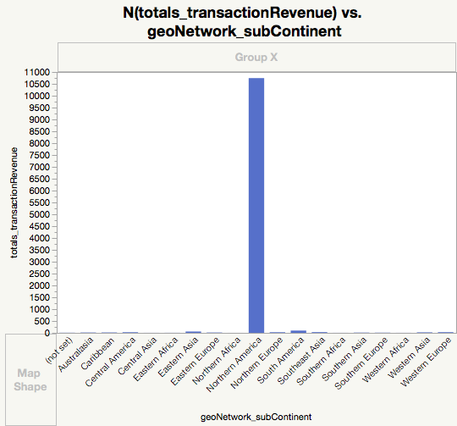
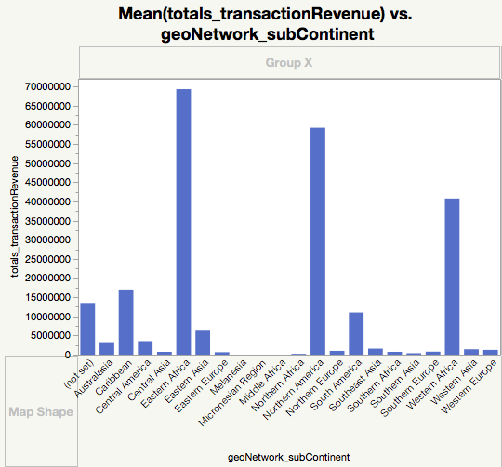
Sub-Continent
Count
Non-zero Revenue Count
Mean Revenue

Slide 14
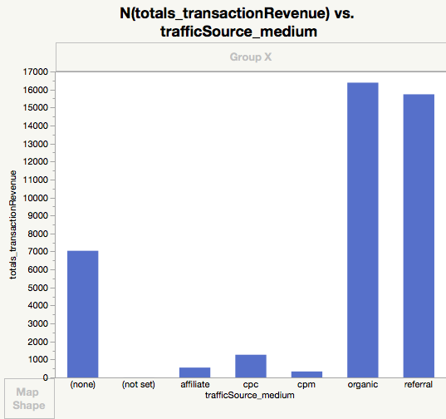
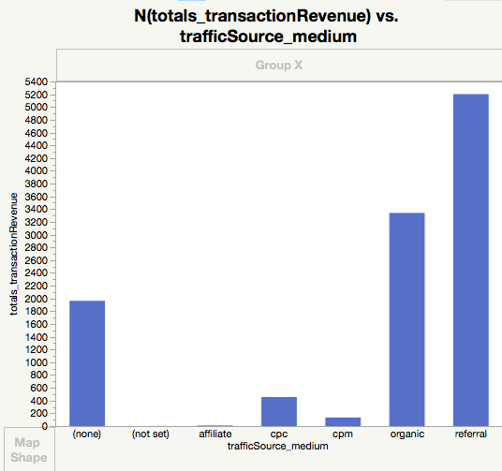
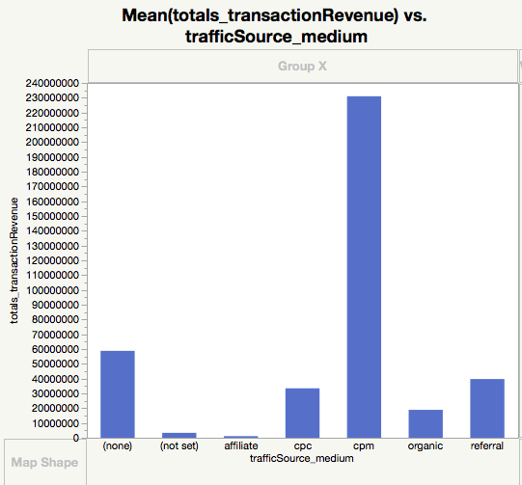
Traffic Source Medium
Count
Non-zero Revenue Count
Mean Revenue

Slide 15
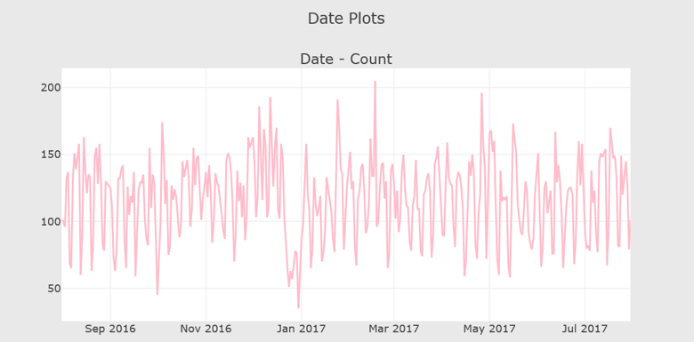
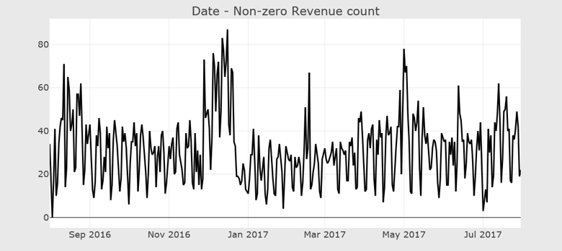
Date Exploration

Slide 16
Model Generation

Slide 17
Classification Model for predicting whether transaction will be made or not :
The main issue we have in this challenge is not to predict revenues but more to get these zeros right since less than 1.3 % of the sessions have a non-zero revenue. The idea is to classify non-zero transactions first and use that for better results for revenues.

Slide 18
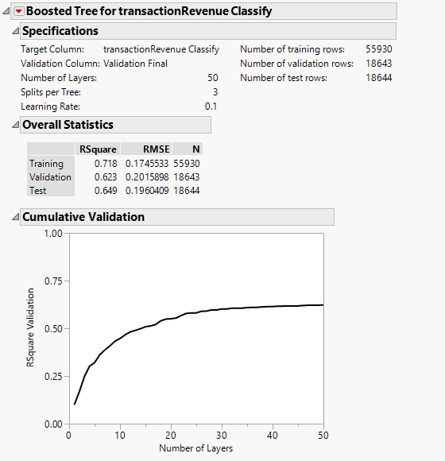
Classification Model

Slide 19
Continuous variable prediction Models

Slide 20
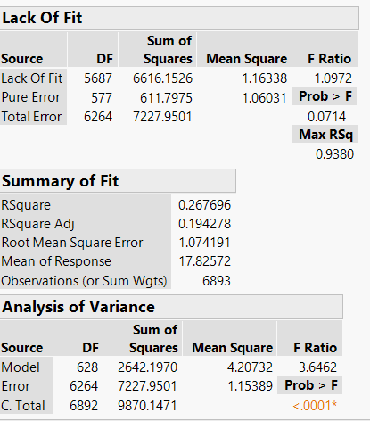
Linear Regression

Slide 21
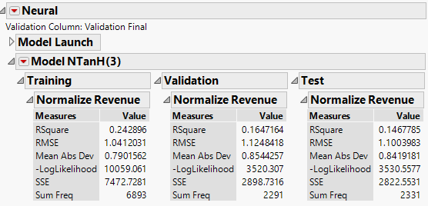
Neural Networks

Slide 22
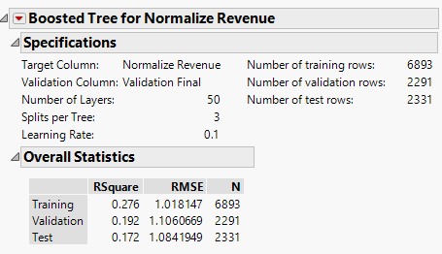
Boosted Trees

Slide 23
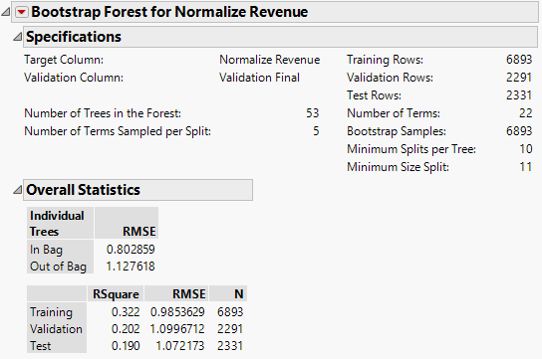
Bootstrap Forest

Slide 24
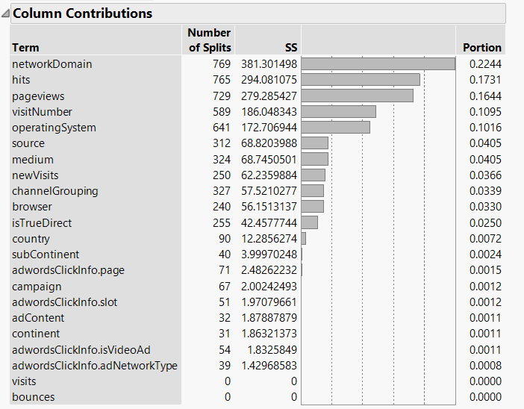
Column Contribution

Slide 25
Model Validation

Slide 26
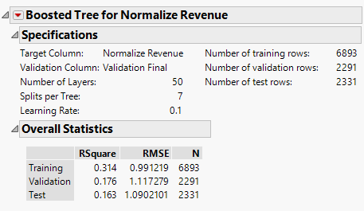
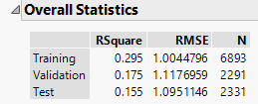
Parameter Tuning
For splits per tree= 3
For splits per tree= 5
For splits per tree= 7

Slide 27
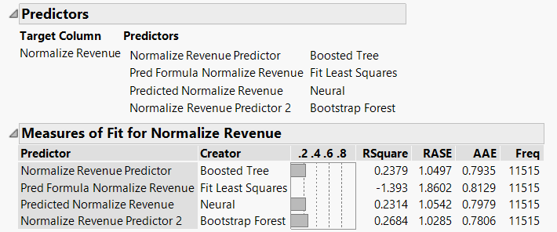
Model Comparison

Slide 28
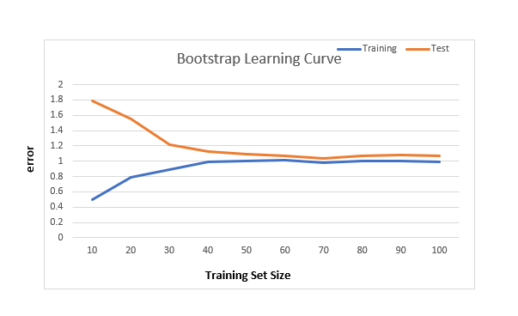
Learning Curve

Slide 29
Conclusion

Slide 30
Insights & Recommendations
Modeling Recommendations:
Initial Classification - Boosted Tree
For log revenue prediction - Bootstrap Forest Model
Business Recommendations:
Spikes in count and revenue in December - holiday offers
Chrome - high count, low mean revenue - GStore could strategize pop-up offers
Target Customer groups in Africa with highest mean revenue
Create marketing strategies targeted at Desktop users - high-value customers

Slide 31
Questions?

